Slide 1
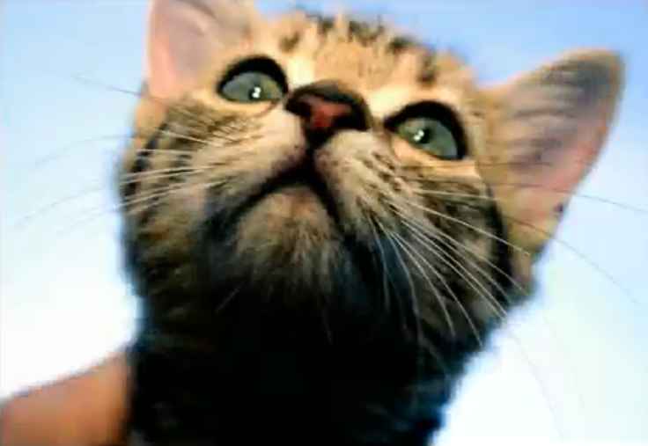
bit.ly/catmakeover
Starter: Watch the “cat makeover”

Slide 2
Introduction to Photoshop
OUTCOME:
Demonstrate knowledge of combining a series of images into one file using Adobe Photoshop.

Slide 3
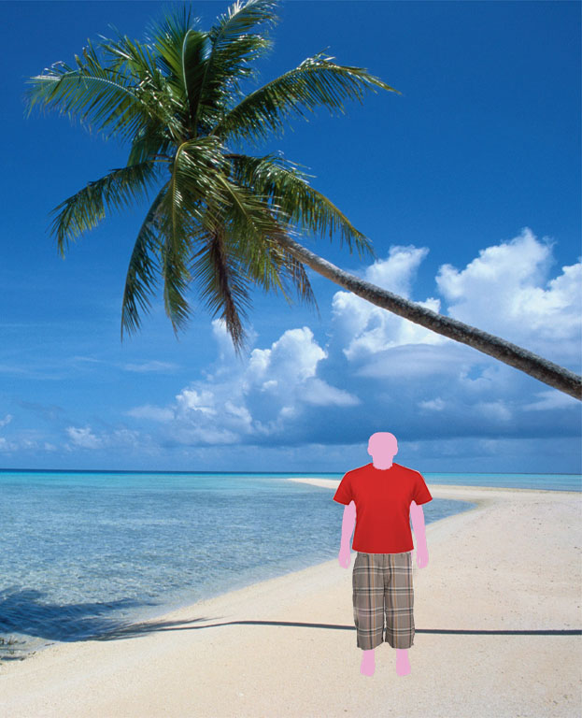

Slide 4
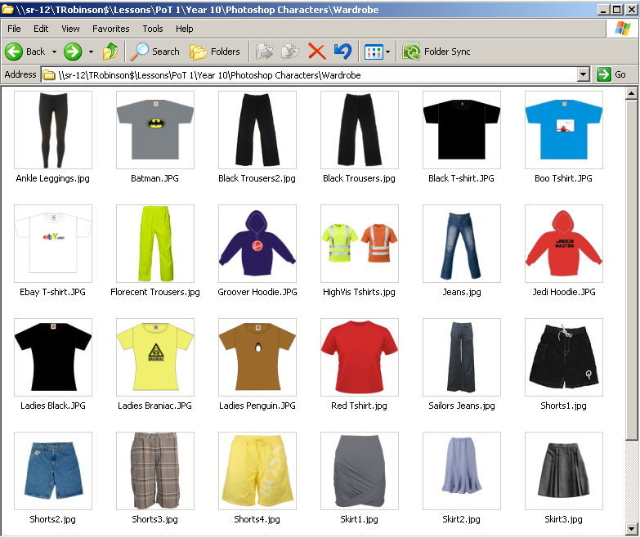
R:\ICT\Yr 10 CiDA\Centre Stage\Photoshop Characters

Slide 5
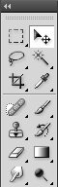
Tools Quiz

Slide 6
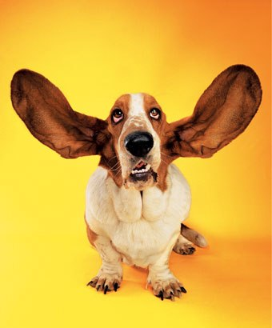
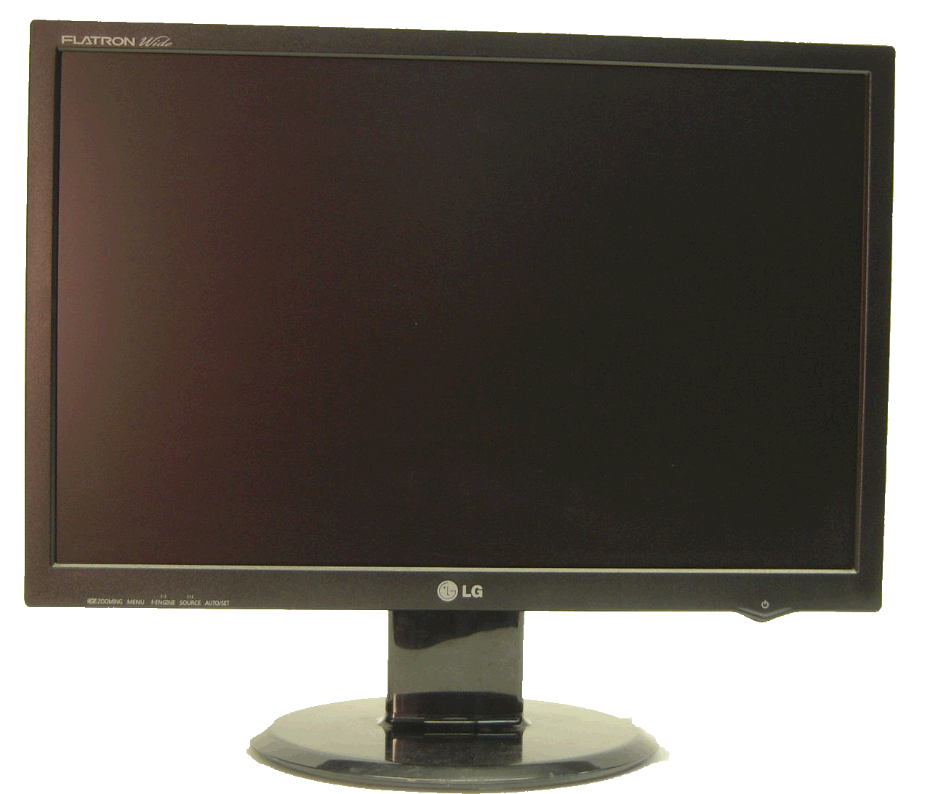
Listen!
Screens Off

